Slide 1
Exception Handling in JAVA
Arvind Bhave

Slide 2
Exception Handling in Java
Exception – exceptional event
Unpredicted event that Occurs while the program is executing
An exception is an abnormal condition that arises in a code sequence at run time.
Run time error
Terminates the program abnormally
When an error occurs within a method, Java runtime system creates an exception object.
Exception object contains information about exception like its type and the state of the program when the error occurred.

Slide 3
Exception Handling in Java
Once an exception object is created , it is thrown and the runtime system searches for a method to handle the exception.
Keeps the searching for a method that contain an appropriate exception handler.
Appropriate exception handler means if the type of exception handled by handler and type of exception thrown is same.

Slide 4
Exception Handling in Java
A program to demonstrate unhandled exception
class ExceptionUnHandling
{
public static void main(String arg[])
{
int a=10;
int b=5;
int c=a/(a-2*b); //exception
System.out.println(“Result….”+c);
}
}

Slide 5
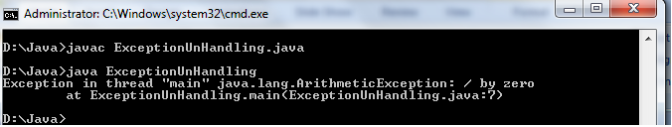
Exception Handling in Java
No compile time errors ,
When divide by zero statement executed, run time error occurs. At this point Java runtime system creates an exception object and throws it.
This thrown object excepts exception handler to handle this error.
No exception handler has been provide in this program, java invokes its default handler.

Slide 6
Exception Handling in Java
Common failures of program
Memory exhaustion
Out of bounds array subscript
Division by zero
Invalid method parameters
Exception Handling
It is a Mechanism for detection and handling of run-time errors also it separates the error handling code from the rest of the program.

Slide 7
Exception handling
Should not be used for program control
Not optimized, can harm program performance
Improves fault-tolerance
Easier to write error-processing code
Specify what type of exceptions are to be caught
Another way to return control from a function or block of code

Slide 8
Exception handling
Catch errors before they occur
Deals with synchronous errors (i.e., divide by zero)
Does not deal with asynchronous errors
Disk I/O completions, mouse clicks - use interrupt processing
Used when system can recover from error
Exception handler - recovery procedure
Error dealt with in different place than where it occurred
Useful when program cannot recover but must shut down cleanly

Slide 9
When Exception Handling Should Be Used
Error handling used for
Processing exceptional situations
Processing exceptions for components that cannot handle them directly
Processing exceptions for widely used components (libraries, classes, methods) that should not process their own exceptions
Large projects that require uniform error processing

Slide 10
Basics of Exception Handling
5 keywords for handling exception
1. try
2. catch
3. finally
4. throw
5. throws
.

Slide 11
try block contains the set of statements that need to be monitored. When exception occurs within try block, it is thrown. This passes the control to catch block which handles exception appropriately.
throw is used to throw the exception explicitly
throws ..sometimes a method may throw exceptions which it can not handle. This must be specified by throws.
finally The code which must be executed whether an exception thrown or not is kept within finally block (optional)

Slide 12
Basics of Exception Handling
Format
Enclose code that may have an error in try block
Follow with one or more catch blocks
Each catch block has an exception handler
If exception occurs and matches parameter in catch block
Code in catch block executed
If no exception thrown
Exception handling code skipped
Control resumes after catch blocks
try{ code that may throw exceptions
}
catch (ExceptionType ref) { exception handling code }

Slide 13
Basics of Exception Handling
Exception handling
Method detects error which it cannot deal with
Throws an exception
Exception handler
Code to catch exception and handle it
Exception only caught if handler exists
If exception not caught, block terminates
Termination model of exception handling
throw point
Place where exception occurred
Control cannot return to throw point
Block which threw exception expires
Possible to give information to exception handler

Slide 14
Types of Exception
Java provides several built in classes which defines all types of exception
Throwable– superclass (all exception classes inherits the methods defined by it)
Two immediate subclasses i)exception ii) error
Throwable
Exception
Error

Slide 15
Exception class : defines exceptions which are thrown by methods of standard java class library or methods defines in the program and can be traped within the program. i.e. program can recovered from these exception
Error class: defines exceptions that do not occur frequently and are difficult to be recovered from.
Ex:- a class file is missing/ system runs out of memory

Slide 16
Checked and Unchecked Exceptions
Checked exceptions
A checked exception is an exception that occurs at the compile time, these are also called as compile time exceptions. These exceptions cannot simply be ignored at the time of compilation, the programmer should take care of (handle) these exceptions.
Any exception that the compiler can recognize is called a checked exception. These are the exceptions that you should handle in your program. If the code in a method can throw a checked exception, then that method must meet one of the following requirements:
It must handle the exception, or
It must have a throws clause listed in the method header.

Slide 17
Unchecked Exception
An unchecked exception is a SUBCLASS of RuntimeException (as well as RuntimeException itself). These exceptions are mostly caused by programmers writing incorrect code. Most of the built-in exceptions (e.g.,ArithmeticException, IndexOutOfBoundsException) are unchecked.
Unchecked exceptions can be caught in a try block, but if not, they need not be listed in the function's throws clause.
These include programming bugs, such as logic errors or improper use of an API. Runtime exceptions are ignored at the time of compilation.

Slide 18
Java’s Unchecked RuntimeException Subclasses
Sr No | Exception | Description
1 | ArithmeticException | Thrown when Arithmetic error, such as divide-by-zero occurs1
2 | ArrayIndexOutOfBoundsException | thrown when an Attempt is made to access array element with invalid array index value
3 | ArrayStoreException | thrown when an attempt is made to store incompatiable type of data in an array
4 | IllegalArgumentException | Illegal argument used to invoke a method.
5 | IndexOutOfBoundsException | Some type of index is out-of-bounds
6 | NegativeArraySizeException | Array created with a negative size

Slide 19
Java’s Unchecked RuntimeException Subclasses
Sr No | Exception | Description
7 | NumberFormatException | Invalid conversion of a string to a numeric format
8 | SecurityException | Attempt to violate security
9 | StringIndexOutOfBounds | Attempt to index outside the bounds of a string.
10 | UnsupportedOperationException | An unsupported operation was encountered.

Slide 20
Java’s Checked RuntimeException Subclasses
Sr No | Exception | Description
1 | ClassNotFoundException | Class not found.
2 | CloneNotSupportedException | Attempt to clone an object that does not implement the Cloneable interface
3 | IOException | Thrown when error occurs during input / output data
4 | IllegalAccessException | When an illegal attempt is made to access a class
5 | InstantiationException | Attempt to create an object of an abstract class or interface.
6 | NoSuchMethodException | A requested method does not exist.

Slide 21
Multiple catch
Multiple exceptions are thrown within try block.
Java makes it possible by using multiple catch blocks
Separate catch block is used for different exception
Syntax
try {…..} catch (exception_type e1){…} catch(exception_type e2){..} catch(exception_type en){..}

Slide 22
Multiple catch
Only one try block from which exceptions are thrown (of different type)
Depending on the type of execution, corresponding catch block will be executed.
After one catch statement executes, the others are bypassed, and execution continues after the try/catch block

Slide 23
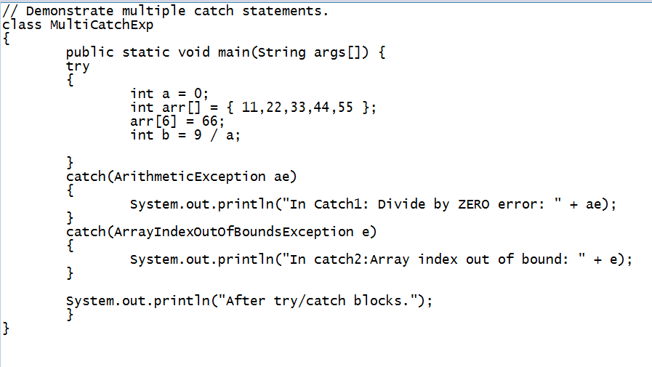
Multiple catch program

Slide 24
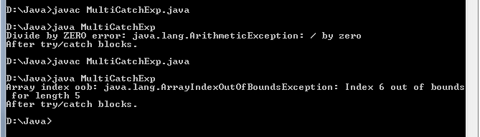
Multiple catch

Slide 25
When you use multiple catch statements, it is important to remember that exception subclasses must come before any of their superclasses.
This is because a catch statement that uses a superclass will catch exceptions of that type plus any of its subclasses.
Thus, a subclass would never be reached if it came after its superclass.

Slide 26
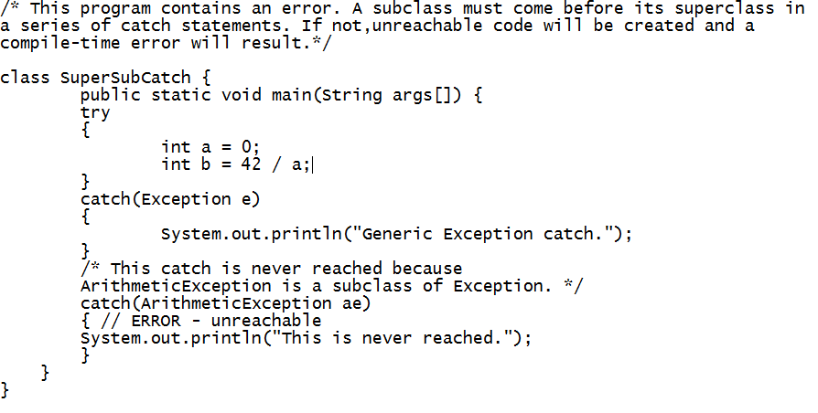

Slide 27
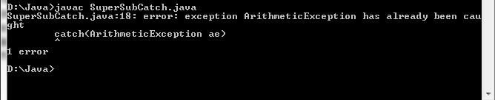

Slide 28
ArithmeticException is a subclass of Exception, the first catch statement will handle all Exception-based errors, including ArithmeticException.
This means that the second catch statement will never execute.
To fix the problem, reverse the order of the catch statements.

Slide 29
Nested try blocks
The try statement can be nested. That is, a try statement can be inside the block of another try.
If an exception occurs in one try block , then associated catch block will be searched for an appropriate match.
If no match found then the control passes passes to the next outer try..catch block.
This process continues until an appropriate match is found.
If no match is found, the program terminates abnormally.

Slide 30
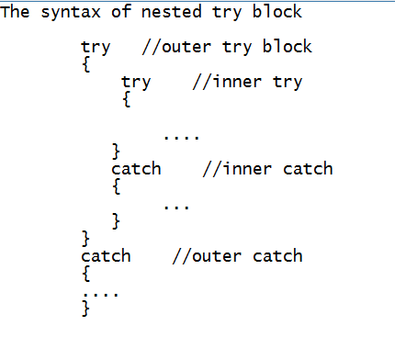

Slide 31
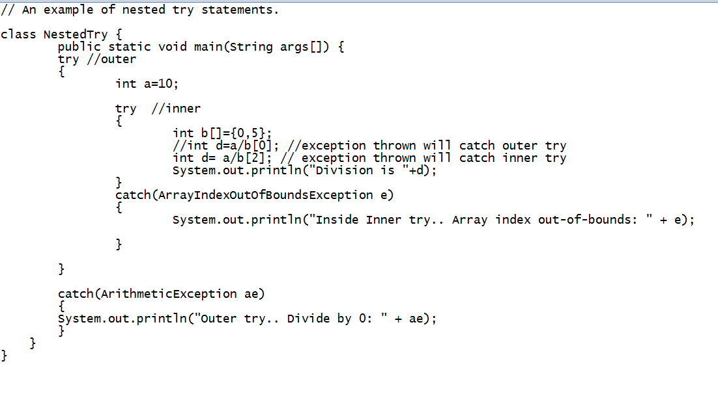
Nested try example

Slide 32
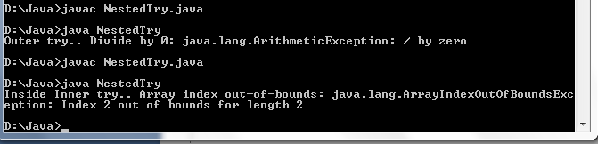

Slide 33
Using finally block
There are certain statements in the program that needs to be executed whether or not exception is raised.
To achieve this finally keyword is used
The code within the finally block will always be executed whether exception is thrown or not.
If an exception is thrown and it founds matching catch block, then finally block will be executed after the execution of catch block.
If an exception is thrown and it does not found matching catch block, then also finally block will be executed after the execution of catch block.

Slide 34
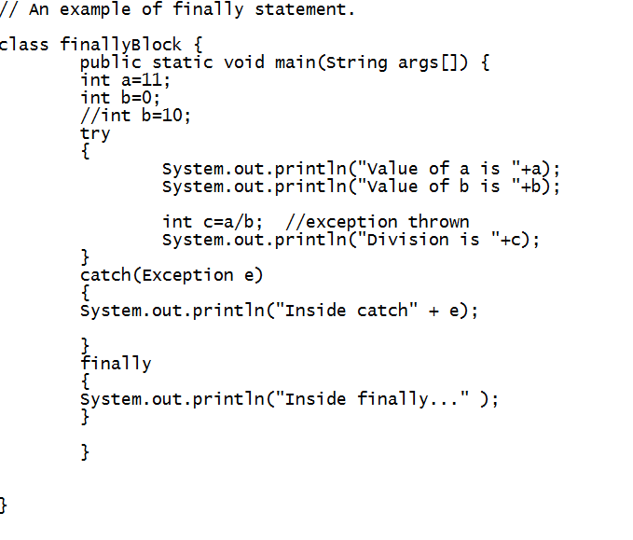

Slide 35
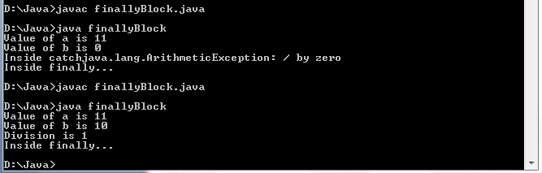

Slide 36
throw
it is possible to throw an exception explicitly, using the throw statement
We can throw either checked or uncheked exception in java by throw keyword.
The throw keyword is mainly used to throw custom exception.
The general form of throw is :
throw ThrowableInstance;
Here, ThrowableInstance must be an object of type Throwable or a subclass of Throwable.

Slide 37
throw
There are two ways you can obtain a Throwable object: using a parameter into a catch clause, or creating one with the new operator.
The flow of execution stops immediately after the throw statement; any subsequent statements are not executed.
The nearest enclosing try block is inspected to see if it has a catch statement that matches the type of the exception. If it does find a match, control is transferred to that statement. If not, then the next enclosing try statement is inspected, and so on.
If no matching catch is found, then the default exception handler halts the program and prints the stack trace

Slide 38
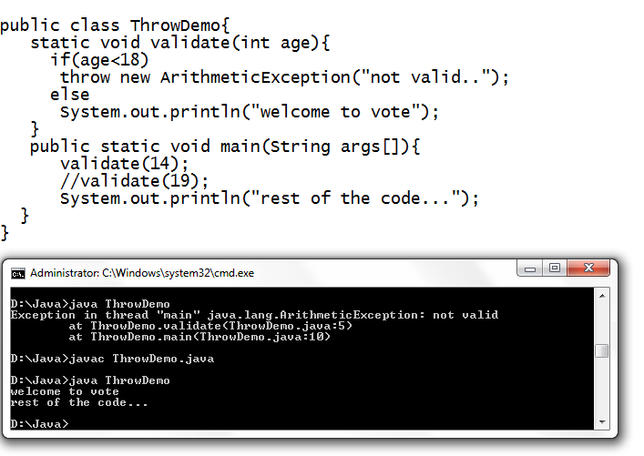

Slide 39
throws
Used to declare an exception
There may be method in the program which is throwing an exception but it does not have the appropriate exception handling mechanism.
If a method is capable of causing an exception that it does not handle, it must specify this behavior so that callers of the method can guard themselves against that exception.
This is done by appending throws keyword after method name in the method declaration statement.
throws clause includes the types of exceptions that a method might throw.
This is necessary for all exceptions, except those of type Error or RuntimeException, or any of their subclasses

Slide 40
throws
The syntax of the throws clause
return_type method_name(parameter_list) throws exception_list
{
//body of the method
}
Where
exception_list includes all the exception ( seperated by comma) that the method might throw

Slide 41
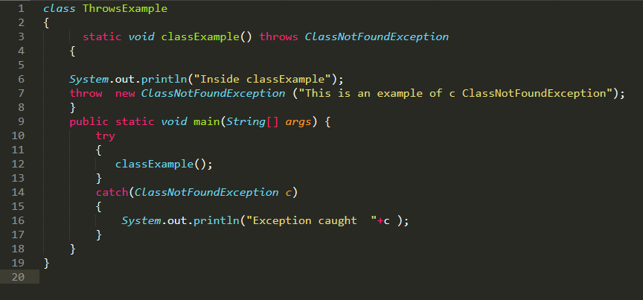

Slide 42
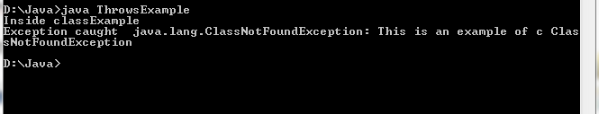

Slide 43
Creating your own exception
User defined exceptions are created by defining subclass of Exception class and using the throw keyword.

Slide 44
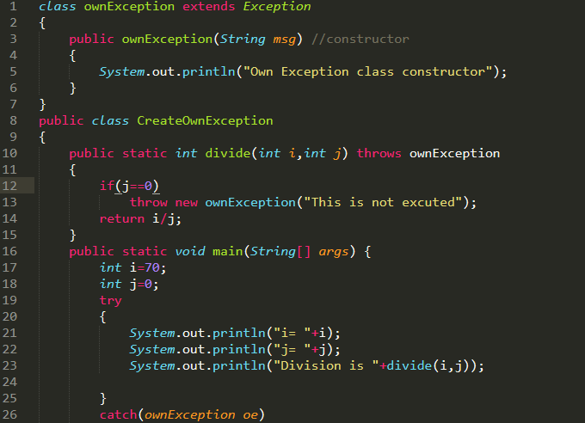
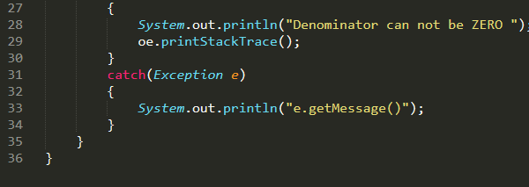

Slide 45
